Slide 1

IBM Data Science Capstone
Opening a Malay Restaurant in Kuala Lumpur, Malaysia
By: Syed Muhammad Bilal Zaidi

Slide 2
Business Problem
The objective of this capstone project is to find the most suitable location for the entrepreneur to open a Malay Restaurant in Kuala Lumpur, Malaysia. By using data science methods and machine learning techniques such as clustering, this project aims to provide solutions to answer the business question: In the city of Kuala Lumpur, if an entrepreneur wants to open a Malay Restaurant, where should they consider opening it?
Target Audience: The entrepreneur who wants to find the location to open new Malay Restaurant.

Slide 3
Data
A complete list of neighborhoods in Kuala Lumpur, Malaysia. Source of the data is Wikipedia.org URL: https://en.wikipedia.org/wiki/Kuala_Lumpur
Geographical coordinates (latitude and longitude) of those neighborhoods. Source of the data will be FourSquare.
FourSquare provided Venue data which is related to Malay restaurants. We will use this data to perform clustering on the neighborhoods.

Slide 4
Methodology
Scrap List of neighborhoods Using BeautifulSoup
Get Latitude and Longitude using Geocoder library
Compile the neighborhood list and Lat Long data in a single DataFrame using Pandas Library
Use Folium library to visualize the DataFrame data on to the map
Register for FourSquare Developer Account to access the API services
Create API call from FourSquare which passes geocoordinates and return location data.
Check how many places returned & check how many unique categories can be curated of all returned values
Analyze each environment by grouping the rows ad taking the mean of the frequency at which each place category occurs.

Slide 5
Methodology (cont-d)
Filter Malay Restaurants data as place category
Cluster the data using K-means Clustering
Group Neighborhood into 3 clusters based on frequency
Clusters would help in identifying which area have most Malays Restaurants and which have the least or no Malay Restaurants.

Slide 6
Results
The cluster results by the k-means algorithm show that regions can be categorized into 3 clusters based on the frequency of occurrence of "Malay Restaurants":
Cluster 0: Areas with the least number of Malay Restaurants frequencies
Cluster 1: Areas with a medium number of Malay Restaurants frequencies
Cluster 2: Areas with the larger number of Malay Restaurants frequencies
The cluster results are visualized on the map below, with cluster 0 colored red, cluster 1 purple, and cluster 2 mint green.

Slide 7
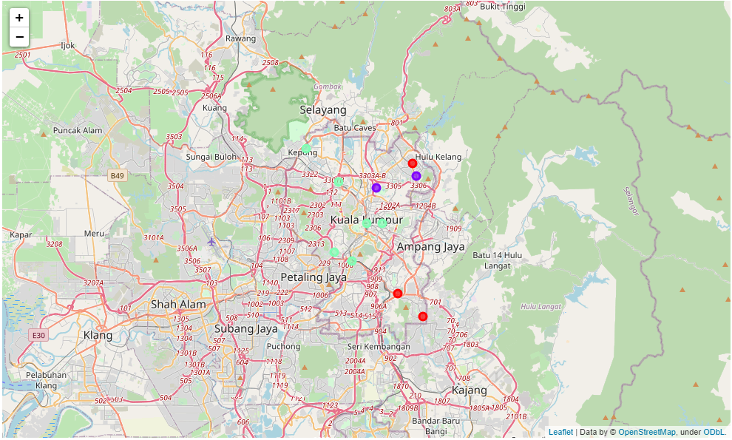
Map

Slide 8
Limitations & Future Research
In this project we only consider one factor, namely the frequency of Malay Restaurants appearances, other factors such as population and income as well as people's interest in hanging out which can influence the decision to locate a new Malay Restaurants. So that further research can design a methodology to use this data to be used in a grouping algorithm to determine a good location to open a new Malay Restaurants.

Slide 9
Conclusion
The environment in cluster 0 is the best location to open a new Malay Restaurants. It is hoped that the findings from this project will help relevant stakeholders to take advantage of opportunities in high potential locations while avoiding overcrowded areas in their decisions to open new Malay Restaurants.

Slide 10
References
List of neighborhoods in Kuala Lumpur: https://en.wikipedia.org/wiki/Kuala_Lumpur
Foursquare Developer Documentation: https://developer.foursquare.com/docs

